Slide 1
CE291 Project Team Challenge TSSS - The Self-Solving Sudoku
10 Aug 2022
Nicholas

Slide 2
Introduction
Ong Li Zhen
Nicholas Pwi
Jason Haw
Wilson Low
Yap Choo Kiat

Slide 3
Agenda
1. Problem Statement
2. Our Journey
3. Our Product
5. Sales
6. Forecast
4. Marketing Plan
Wilson

Slide 4
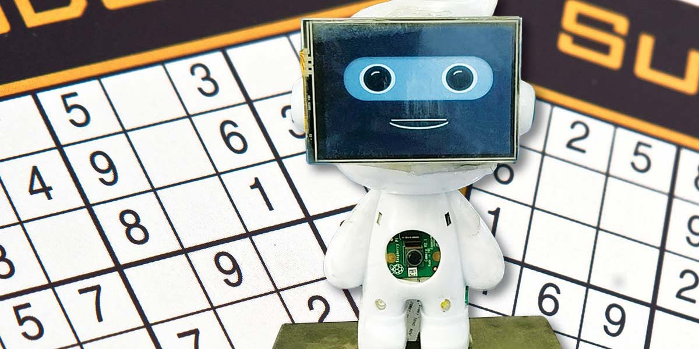
Problem Statement
Our players wanted an intelligent self-solving game to kill their boredom and satisfy their curiosity in the level of intelligence possible.
Wilson

Slide 5
Our Journey
1. Brainstorm
We considered PacMan, Maze, Bubbles, Snakes, Space Invaders as these were 2D games that could be “self-solved”.
2. Research & Development
As there were too many ideas in the brainstorming stage, we only performed R&D on Maze, PacMan and Sudoku as they were “flatter” type of games with lesser exception and could still deliver the excitement and analysis.
3. Deciding On Game
4. MVP
We eventually decided to go with Sudoku with a democratic vote by the team.
For our MVP, we managed to develop a Sudoku with main menu and self-solver at a basic level, took on more feedbacks and fully developed our full product.
Li Zhen

Slide 6
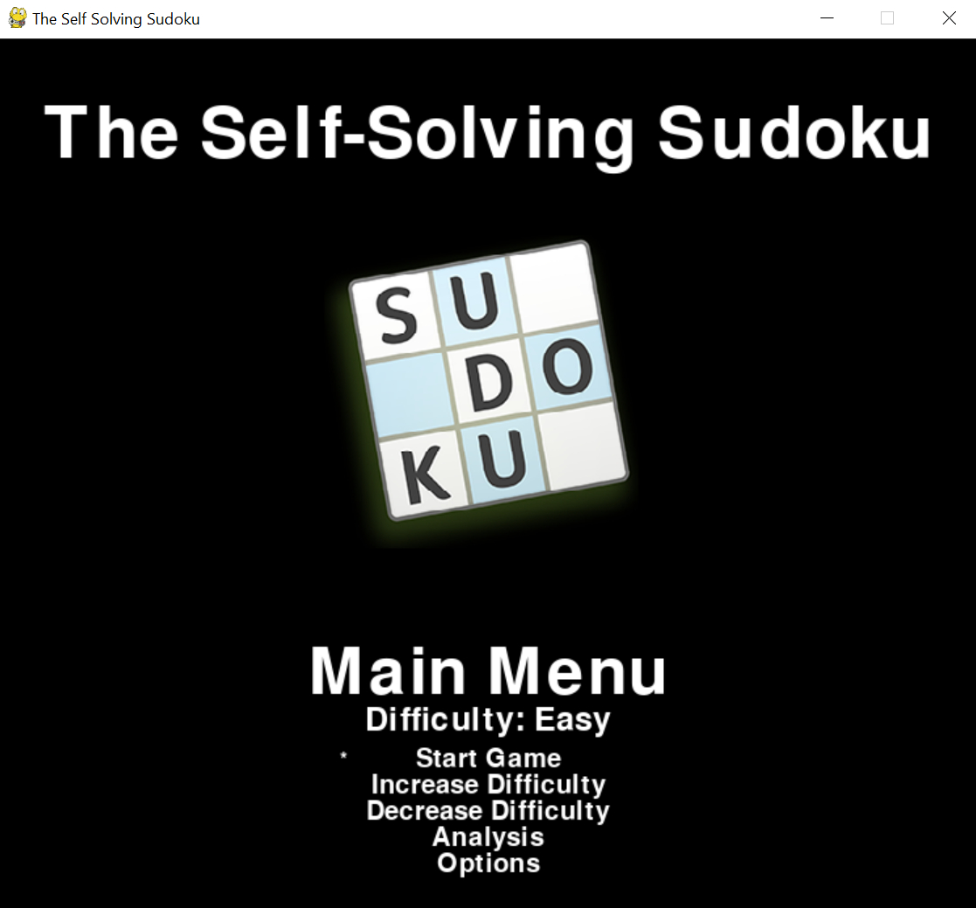
Our Product – Main Menu Feature
Difficulty setting is reflected immediately upon change to provide users with an immediate feedback experience.
Series of other in game navigation with ease of use and understanding for users to immediately start using without explanation
CK

Slide 7
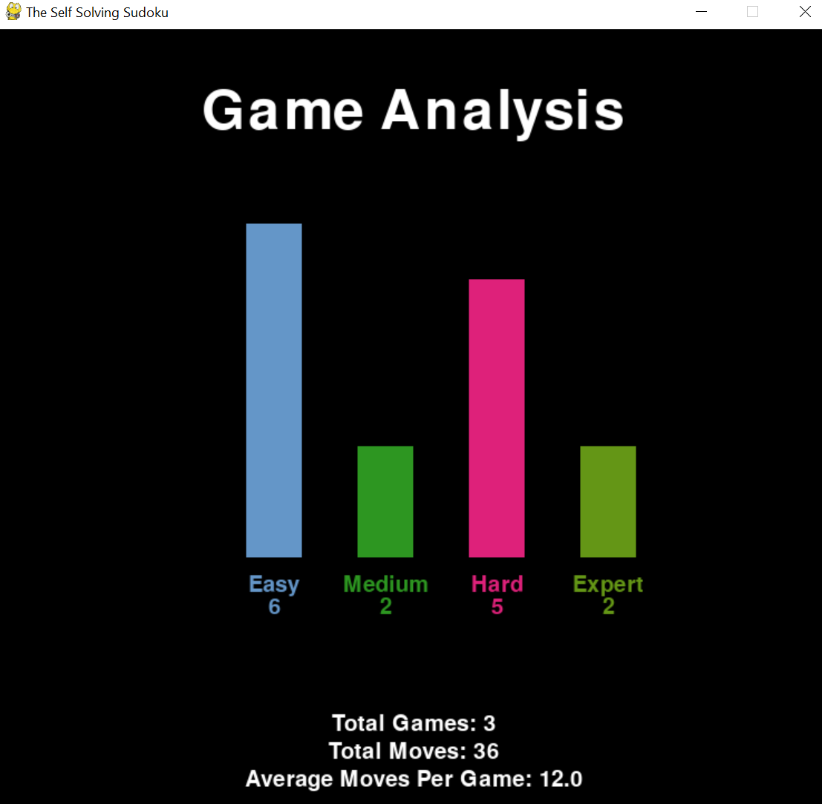
Our Product – Analysis Feature
Color differentiation to help users quickly catch the story told by the charts
Additional details with averages for total to give the user an insight to how well the self-solving tool is working
CK

Slide 8
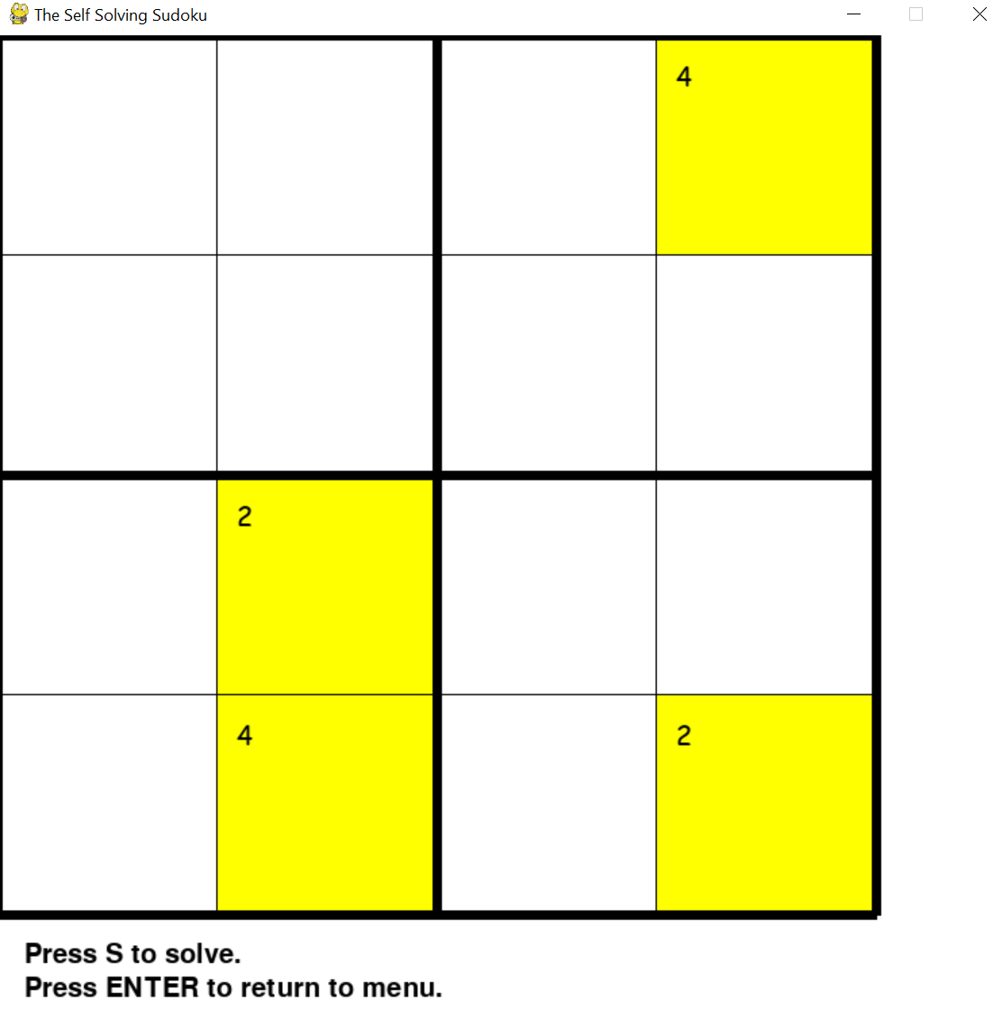
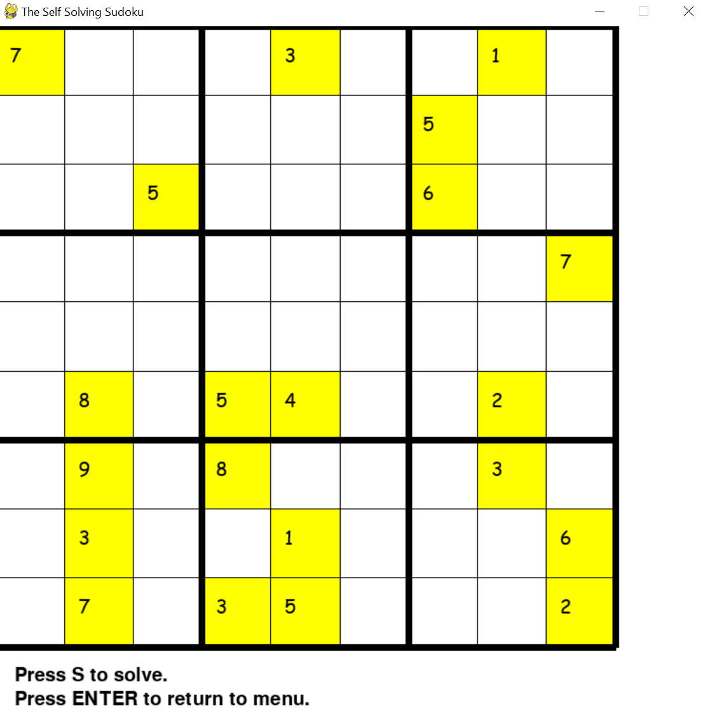
Our Product – Generator Feature
Easy
Level generator is developed with pseudo-random algorithm to provide users with best in-class experience
The grids are generated by running multiple loops based on the difficulty chosen.
We have chosen light colored along with yellow highlight to complement the dark looking menu for contrast.
Medium
Jason

Slide 9
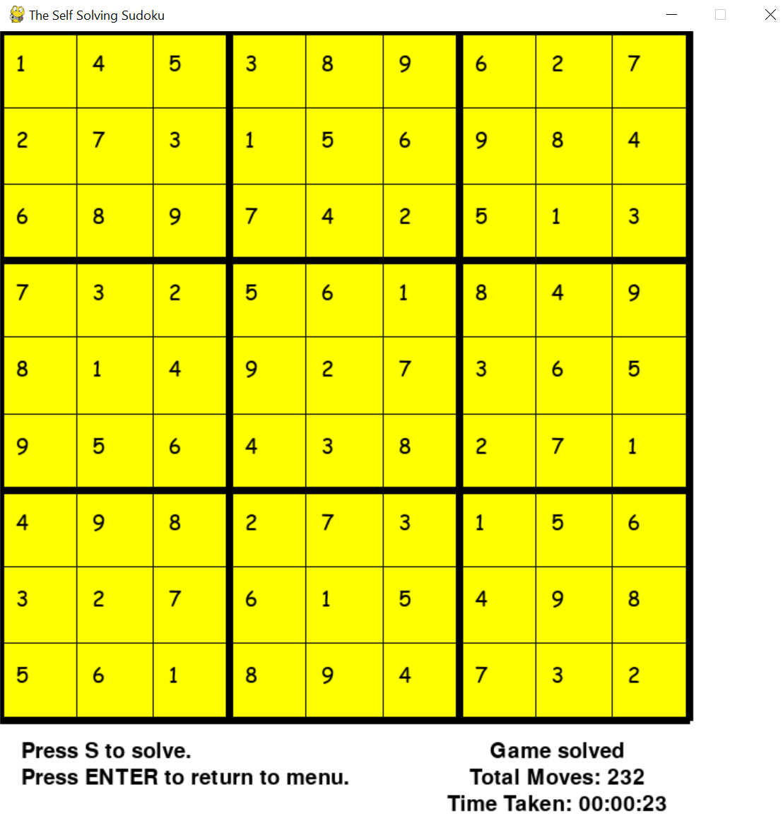
Our Product – Solver Feature
Solver logic uses a backtracking method to try out possible combination and returns to previous cells to amend whenever required.
We have chosen backtracking method as it allows the program to take time to complete the puzzle and would provide the user an experience and satisfaction of seeing the self-solver working.
Jason

Slide 10
Product Demo
Real-time showcase

Slide 11
Marketing Plan
Our key monetization piece will be via the community outreach for Council for Third Age, I Feel Young SG and MySkillsFuture.
Lowered cost-to-buy with effective development methodology
Available on any platforms through internet, app store, pre-installed in new devices
Multi-tier Sudoku
50% more economical
Outreach to elderly
Available on all platforms
Community

Slide 12
Our Sales - Against Competitors
Nicholas

Slide 13
Our Forecast – 8 months
Nicholas

Slide 14
Q&A
End-Of-Session

